Slide 1
🎯 InterviewAI Pro
Your AI-Powered Interview Coach
Presented by: P. Sri Nithya
Roll No: 2303A51546
Department: Computer Science & Engineering
Institution: SR University
Subject: AI Assistant | Academic Year: 2024–25

Slide 2
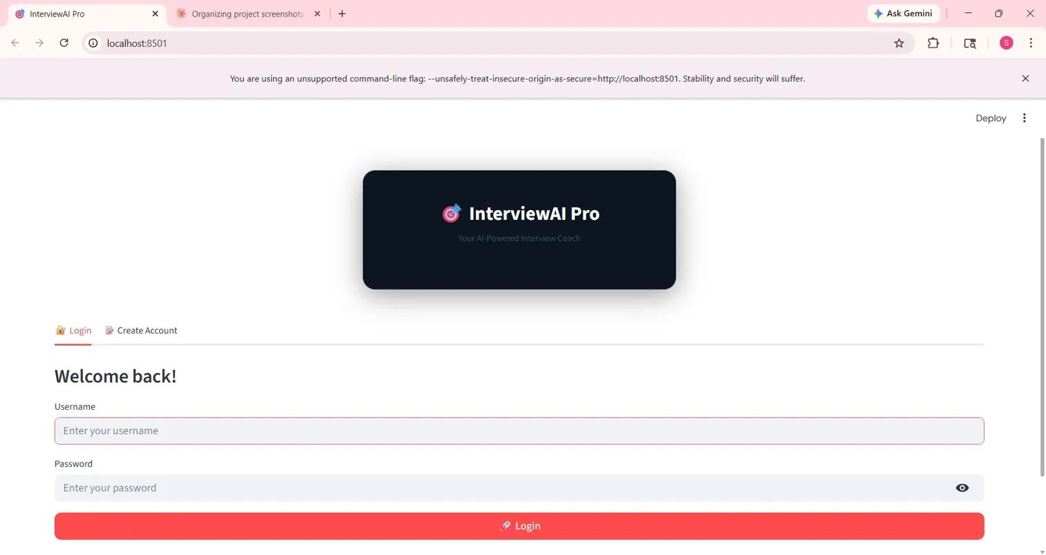
Slide 2 — Introduction of Project
What is InterviewAI Pro?
App Preview — Login Screen
▸ InterviewAI Pro is a full-stack, AI-powered mock interview platform designed for students and professionals.
▸ It simulates real interview scenarios using OpenAI GPT-3.5-turbo to generate dynamic questions and evaluate answers.
▸ The platform supports multiple interview modes: HR, Technical, and Mixed, with voice and resume-based interviews.
▸ Users can practice coding challenges in Python with live AI feedback on correctness and efficiency.
▸ A Performance Dashboard tracks progress and a Global Leaderboard fosters healthy competition.
▸ Built with Python (Streamlit + FastAPI), it runs locally and provides a seamless, interactive experience.
localhost:8501 | Built with Python, Streamlit, FastAPI & OpenAI

Slide 3
Slide 3 — Objectives
01
02
AI-Driven Mock Interviews
Voice-Based Practice
Simulate realistic HR, Technical & Mixed interview sessions using GPT-3.5-turbo.
Enable browser-mic voice interviews with automatic transcription and AI evaluation.
03
04
Resume-Personalized Questions
Coding Challenge Module
Parse uploaded resumes and generate personalised interview questions from the candidate's experience.
Provide Python coding problems with difficulty levels and instant AI feedback on solutions.
05
06
Performance Analytics
Competitive Leaderboard
Track scores, trends, and progress via a dedicated Performance Dashboard.
Motivate users through a Global Leaderboard showcasing top performers.

Slide 4
Slide 4 — Stakeholders
🎓
💼
🏫
Students
Job Seekers
Educational Institutions
Primary users who practice mock interviews to improve their interview readiness before placements.
Professionals switching careers who need structured interview practice across multiple domains.
Colleges and universities integrating the platform into placement training programs.
🤖
👨‍💻
📊
AI / LLM Providers
Developer / Creator
Evaluators / Faculty
OpenAI (GPT-3.5-turbo) — provides the intelligence powering question generation and answer evaluation.
P. Sri Nithya — designs, builds, and maintains the platform; responsible for all code and AI integration.
Faculty members who assess the project quality, functionality, and student knowledge during evaluation.

Slide 5
Slide 5 — Programming Languages, Tools & Software
Layer | Technology | Purpose
Frontend | Python — Streamlit | Interactive web UI, routing, components
Backend | Python — FastAPI | REST API, auth endpoints, data processing
AI / LLM | OpenAI GPT-3.5-turbo | Question generation & answer evaluation
NLP | spaCy + NLTK | Resume parsing & text analysis
Database | SQLite | User accounts, sessions, scores
Voice | Web Speech API | Browser microphone transcription
Video | Browser MediaRecorder API | Camera + recording support
Resume | PyPDF2 | PDF resume text extraction
AI Tools | ChatGPT / GitHub Copilot | AI-assisted code generation

Slide 6
Slide 6 — Prompts Used to Generate Code (Part 1 of 2)
Prompt 1 — Login & Signup System
"Create a Streamlit login and signup page with username/password fields, store user credentials in SQLite using Python, and show a welcome message after successful login."
Prompt 2 — Mock Interview Question Generator
"Using OpenAI GPT-3.5-turbo API in Python, generate HR, Technical, and Mixed interview questions for a given job role. Include a 30/60/90 second countdown timer per question."
Prompt 3 — Voice Interview Module
"Build a Streamlit component that uses the browser Web Speech API to capture microphone audio, transcribe the user's spoken answer, and send it to OpenAI for evaluation."
Prompt 4 — Resume-Based Interview
"Write a Python function using PyPDF2 to extract text from an uploaded PDF resume, then use OpenAI API to generate personalised interview questions based on the candidate's experience."

Slide 7
Slide 6 — Prompts Used to Generate Code (Part 2 of 2)
Prompt 5 — Coding Challenge Module
"Create a Streamlit page that presents Python coding problems (Easy/Medium/Hard) with a live countdown timer. Accept user code input and send it to OpenAI to evaluate correctness, efficiency, and style."
Prompt 6 — Performance Dashboard
"Build a Streamlit performance dashboard that reads session data from SQLite and displays score trends, total sessions completed, and average scores using charts."
Prompt 7 — FastAPI Backend Routes
"Generate FastAPI Python routes for user authentication (login/signup), saving interview session results to SQLite, and retrieving leaderboard data sorted by score."
Prompt 8 — Global Leaderboard
"Create a leaderboard page in Streamlit that fetches all users with 3+ completed sessions from SQLite and displays them ranked by average score with username and total sessions."

Slide 8
Slide 7 — Workflow Flowchart
User Visits App
Login / Signup
Select Interview Mode
HR / Technical / Mixed
Voice Interview
Resume Interview
Coding Challenge
AI Evaluates Answer
Save to Dashboard

Slide 9
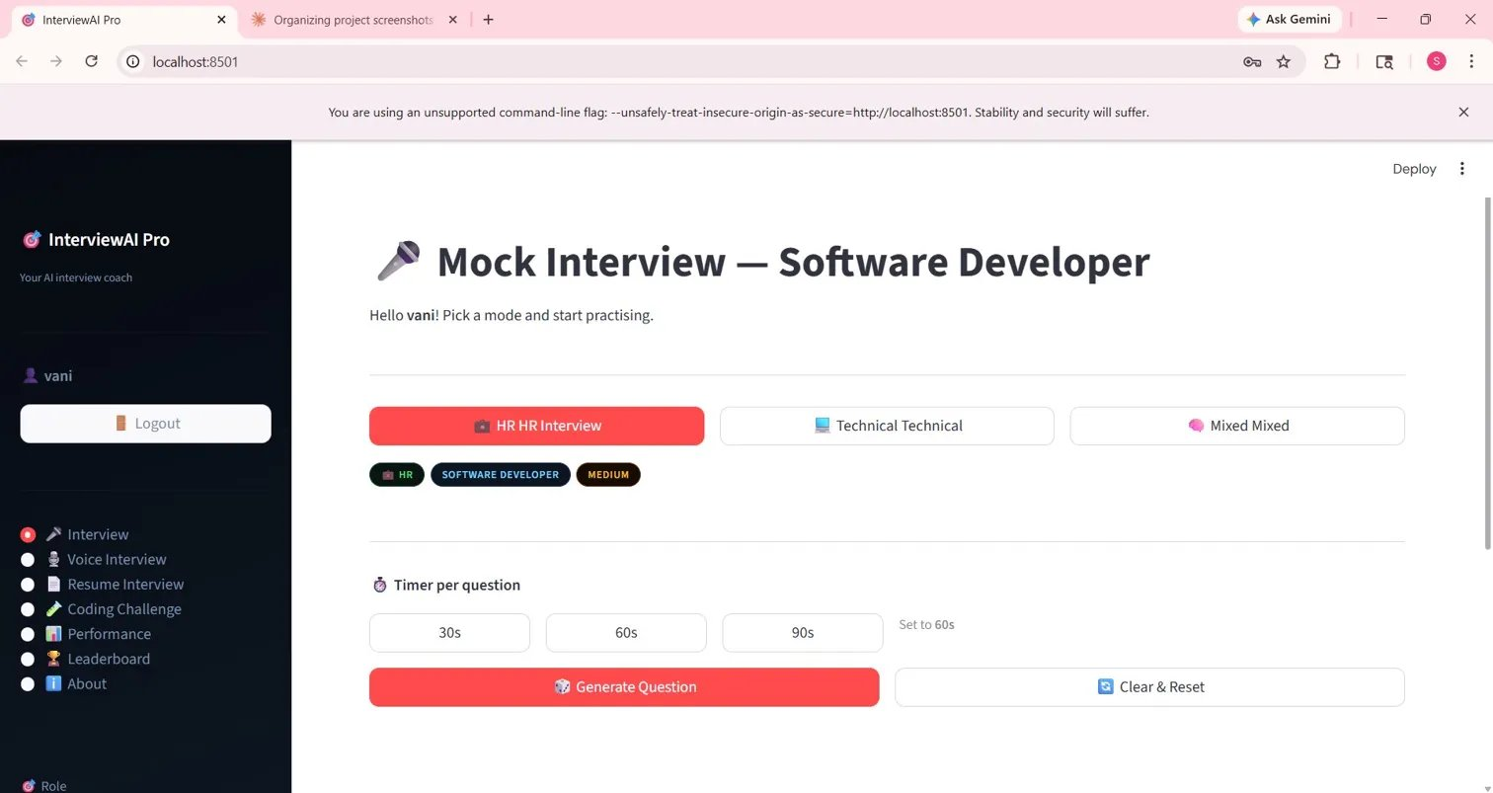
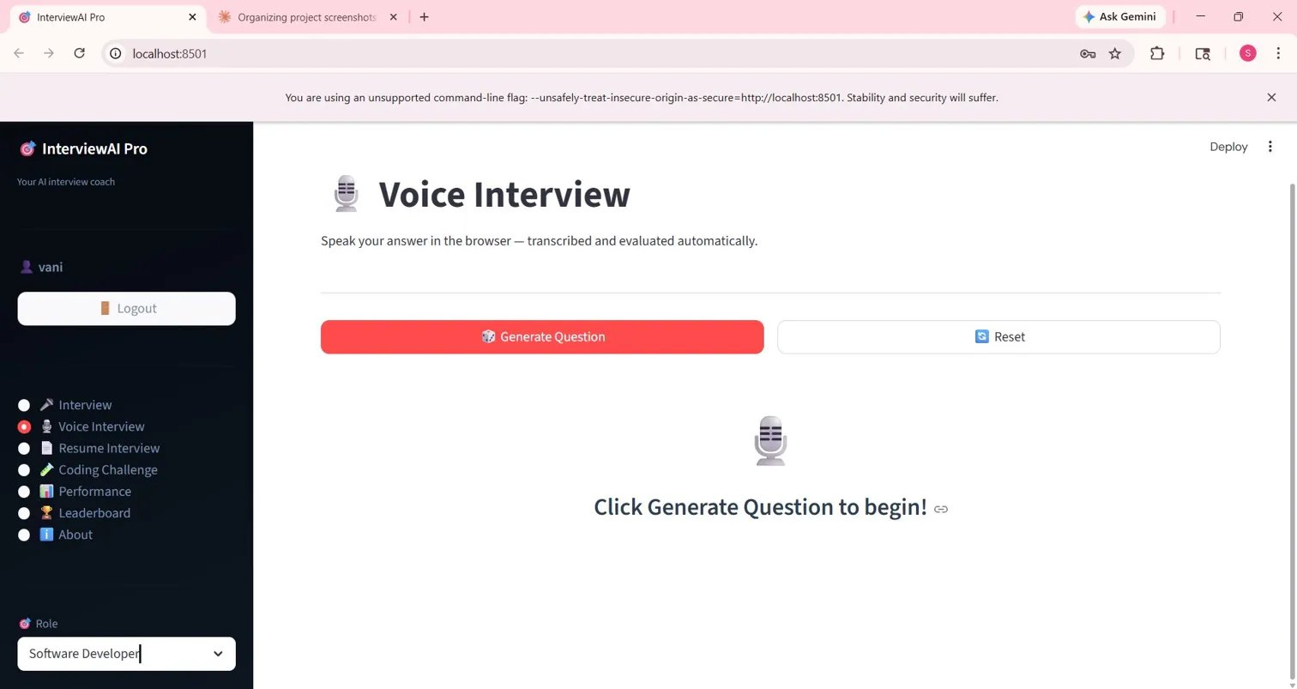
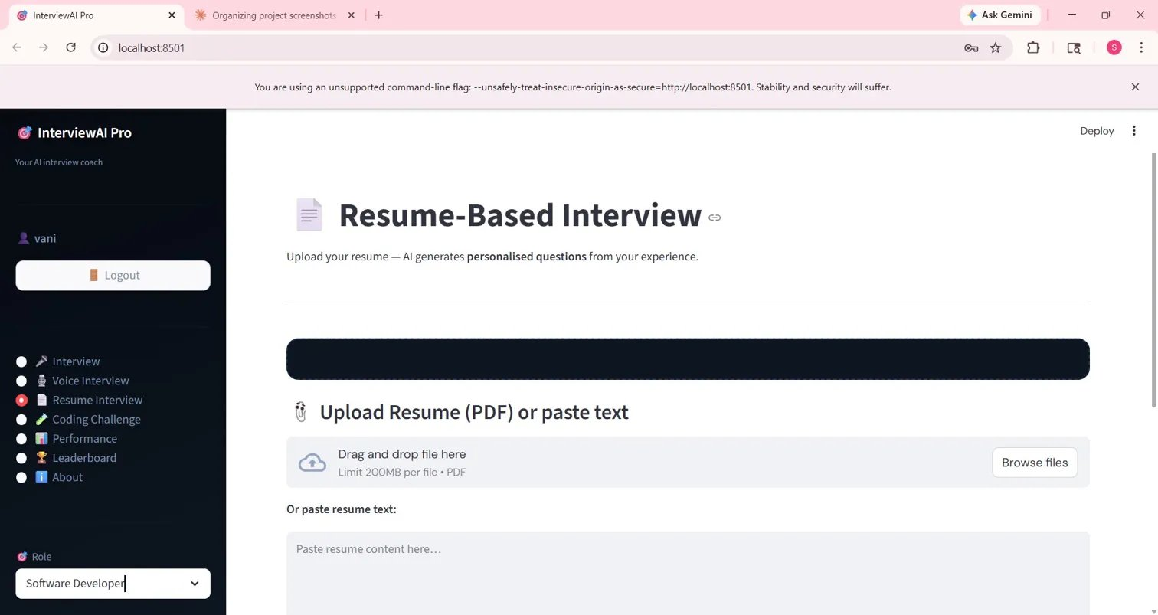
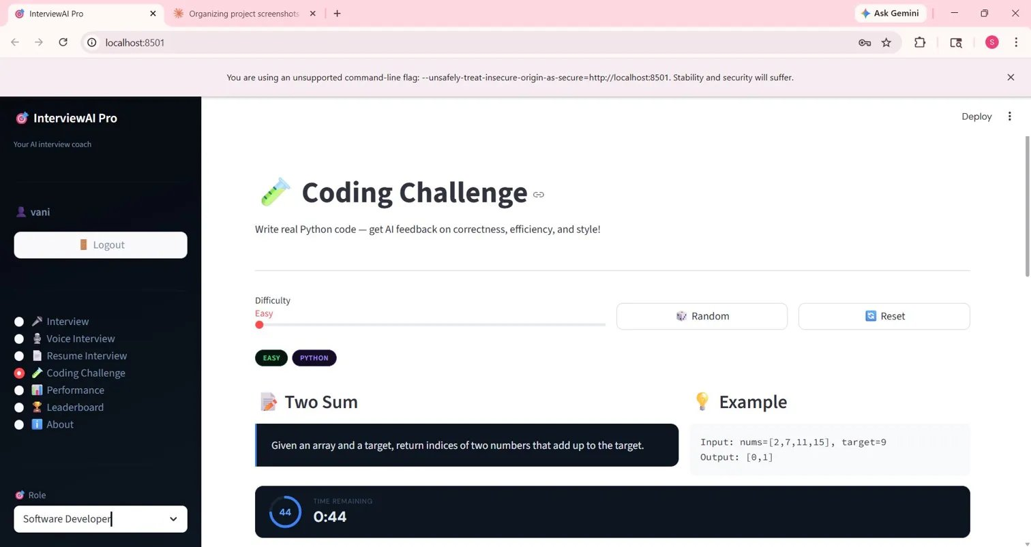
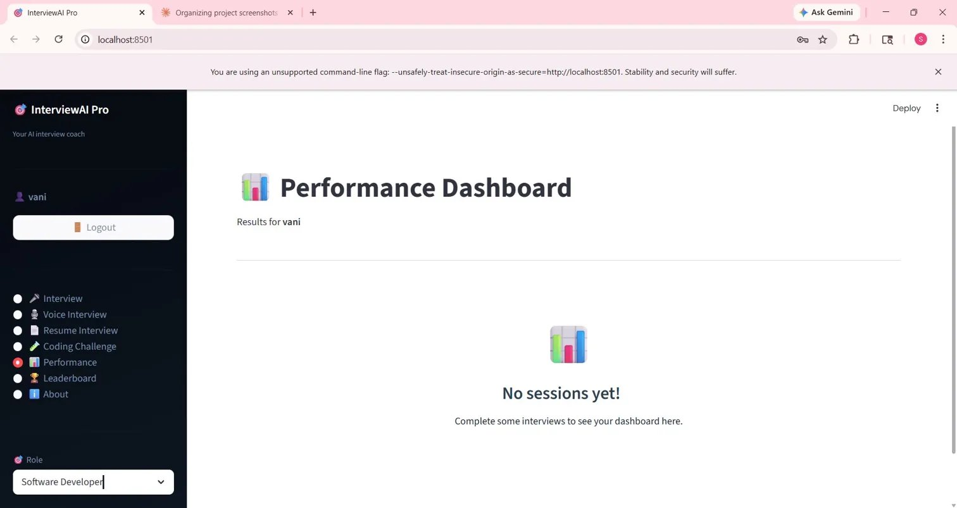
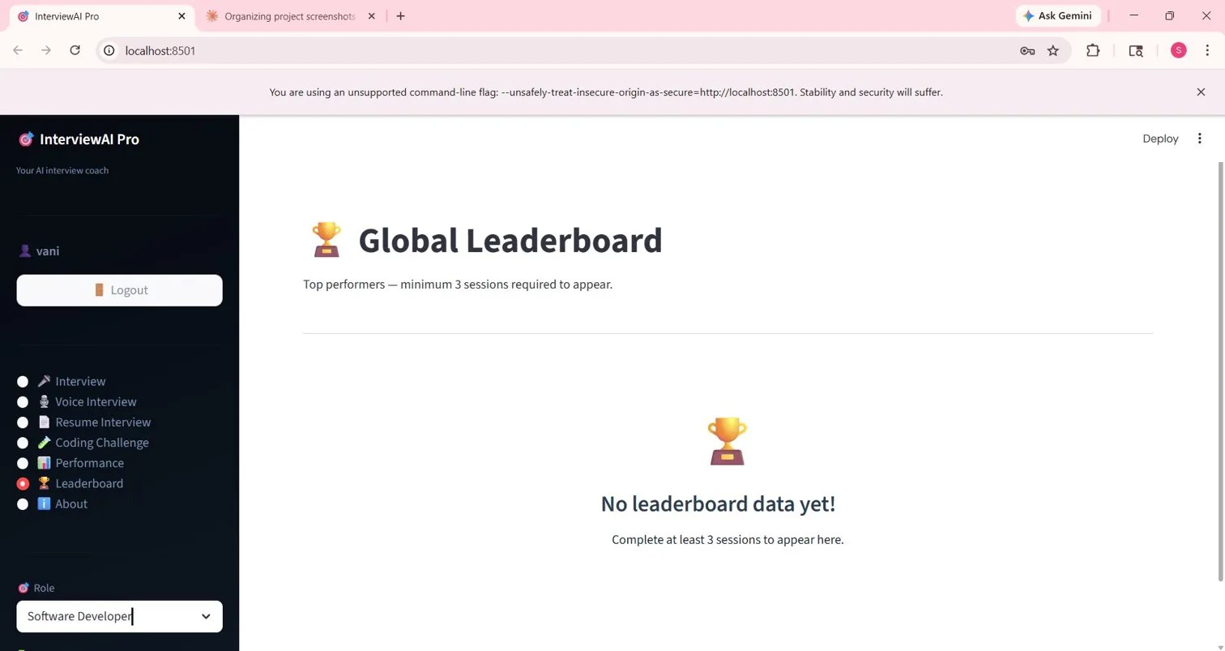
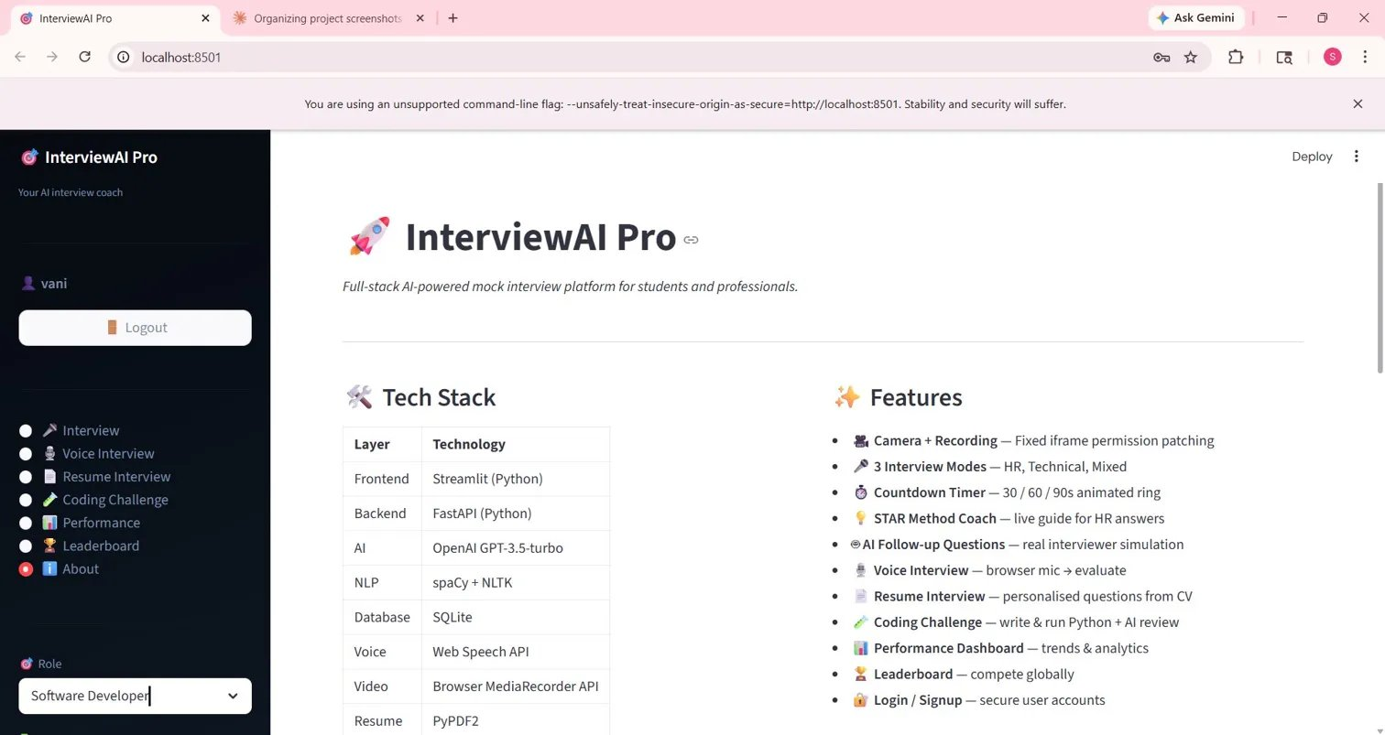
Slide 8 — Front-End View of Web Application
Login Screen
Mock Interview
Voice Interview
Resume Interview
Coding Challenge
Performance Dashboard
Global Leaderboard
About & Tech Stack

Slide 10
Slide 9 — Proof of Prompts Generating Code (Screenshots)
Mock Interview — AI-Generated Question
Coding Challenge — AI Problem + Timer
Resume Interview — Personalised Questions
About Page — Full Tech Stack & Features

Slide 11
Slide 10 — References
[1] OpenAI API Documentation — GPT-3.5-turbo models, chat completions, and prompt engineering guide. https://platform.openai.com/docs
[2] Streamlit Documentation — Building interactive web applications entirely in Python. https://docs.streamlit.io
[3] FastAPI Documentation — High-performance Python web framework for building REST APIs. https://fastapi.tiangolo.com
[4] spaCy Documentation — Industrial-strength Natural Language Processing library for Python. https://spacy.io/usage
[5] NLTK (Natural Language Toolkit) — Platform for building Python programs to work with human language data. https://www.nltk.org
[6] PyPDF2 Library — Python library for reading and extracting text from PDF files. https://pypdf2.readthedocs.io
[7] Web Speech API — MDN Web Docs — Browser API for speech recognition and synthesis. https://developer.mozilla.org/en-US/docs/Web/API/Web_Speech_API
[8] SQLite Documentation — Serverless, self-contained, lightweight relational database engine. https://www.sqlite.org/docs.html
[9] GitHub Copilot — AI pair programmer used for assisted code generation throughout the project. https://github.com/features/copilot
InterviewAI Pro · P. Sri Nithya (2303A51546) · SR University, CSE · 2024–25

